Slide 1

AI-Based Real-Time Face Monitoring System for Online Proctoring
Presented By:
M. Kushal Virendra Chowdary
Batch No: 436

Slide 2
About me
I am a recent B.Tech graduate in Artificial Intelligence and Data Science from Vignan Institute of Technology and Science.
As an AI & DS student, I have the passion and interest to learn Data Science and apply it to solve real-world problems
LinkedIn - https://linkedin.com/in/kushal-manduri
GitHub - https://github.com/kushal1989

Slide 3
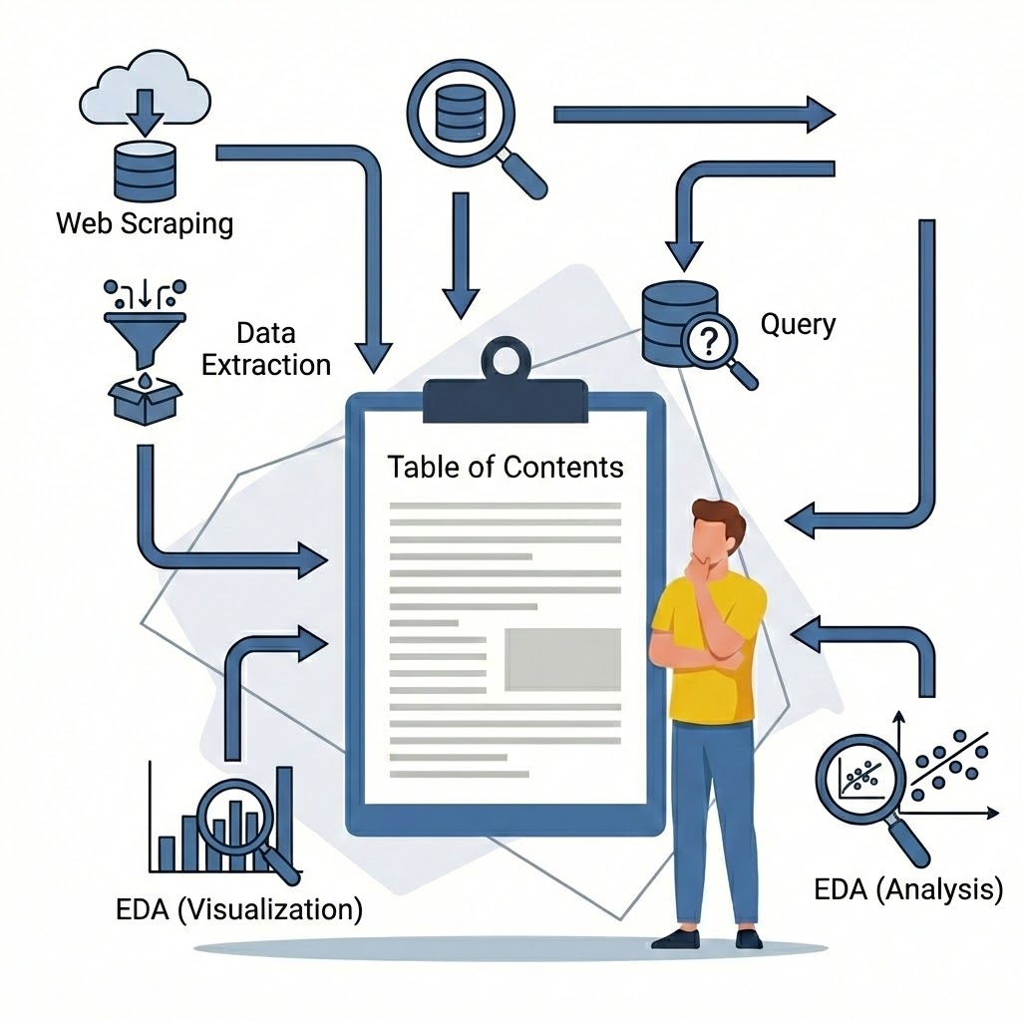
Table of Contents
Business Problem statement
Project Objective
Introduction
Technologies Used
Face Detection Module
Working
Demo
Advantages
Challenges
Conclusion
Q&A

Slide 4
Business Problem Statement
The rapid adoption of online exams, interviews, and certification tests across educational institutions and corporate platforms has introduced significant challenges in maintaining assessment integrity. Remote assessments often lack effective supervision, allowing issues such as candidate absence, impersonation, and multiple individuals appearing on camera to go undetected.
These challenges compromise the credibility of evaluations, lead to unfair assessment outcomes, and reduce trust in online examination systems. Manual monitoring by human proctors is expensive, error-prone, and not scalable, creating a strong need for an automated and reliable monitoring solution.

Slide 5
Project Objective
The primary objective of the AI-Based Real-Time Face Monitoring System for Online Proctoring is to continuously monitor candidates through live webcam input in order to detect face absence and multiple faces during an active session. The system aims to generate real-time alerts and logs for suspicious activities, thereby improving fairness, transparency, and integrity in online examinations.
Secondary objectives include reducing dependency on manual invigilators, providing automated and time-stamped evidence for examination violations, enabling scalable remote assessment monitoring, and supporting cost-effective proctoring solutions for educational institutions and organizations.

Slide 6
Introduction
This project presents an AI-based real-time face monitoring system that uses computer vision to continuously observe candidates through a webcam. The system detects face absence, multiple faces, and suspicious head movements during an active session.
By generating real-time alerts, capturing visual evidence, and maintaining detailed logs, the system improves exam integrity while reducing dependency on human invigilators. The solution is scalable, cost-effective, and suitable for modern online assessment platforms.

Slide 7
Technologies Used
OpenCV - OpenCV is used to capture webcam video, process image frames, and display the real-time monitoring interface.
Mediapipe - MediaPipe is used to perform real-time face detection and provide face location data for movement analysis and monitoring.

Slide 8
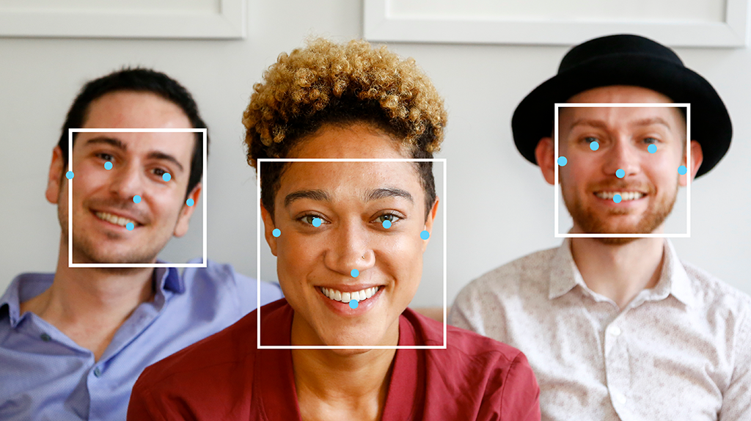
Face Detection - Mediapipe
Mediapipe provides a pre-trained, real-time face detection model optimized for live video streams.
It detects human faces in each video frame and returns their location as bounding boxes.
The model is based on lightweight deep learning, making it fast and suitable for real-time applications.
It supports single-face and multi-face detection, which helps identify impersonation scenarios.
Mediapipe works efficiently on CPU without requiring a GPU, enabling easy deployment.
The detected face coordinates are used for further analysis, such as movement tracking and presence monitoring.

Slide 9
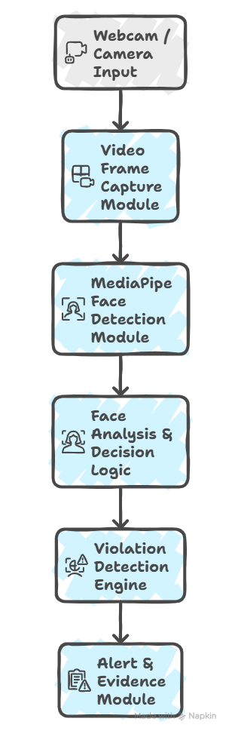
Working
The system starts by capturing live video frames from the user’s webcam in real time.
Each video frame is converted into a suitable format and passed to the MediaPipe face detection model.
The face detection module identifies the number of faces present in the frame and returns their bounding box coordinates.
If no face is detected, the system marks the event as Face Missing.
If more than one face is detected, the system flags it as Multiple Faces Detected.
When a single face is detected, the system tracks the face position to analyze left and right head movements.
The detected behavior is classified as normal or suspicious based on predefined conditions and time thresholds.
On detecting any violation, the system triggers an alert, captures a screenshot, and logs the event with a timestamp in a CSV file.

Slide 10
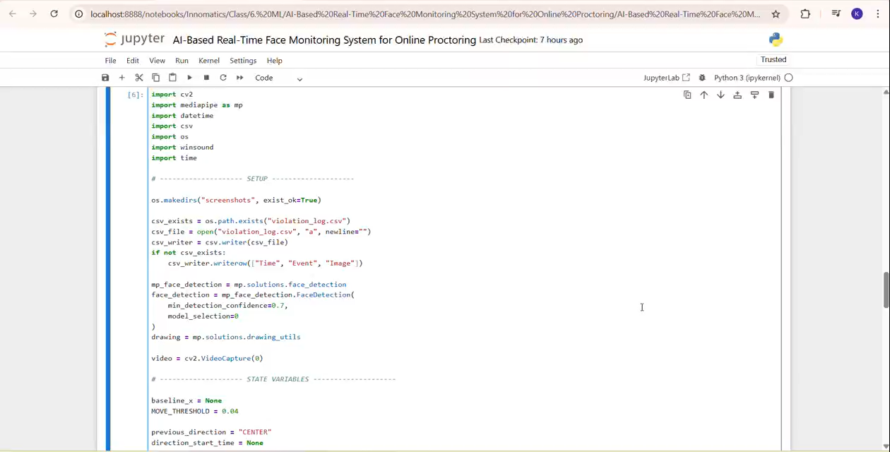
Demo

Slide 11
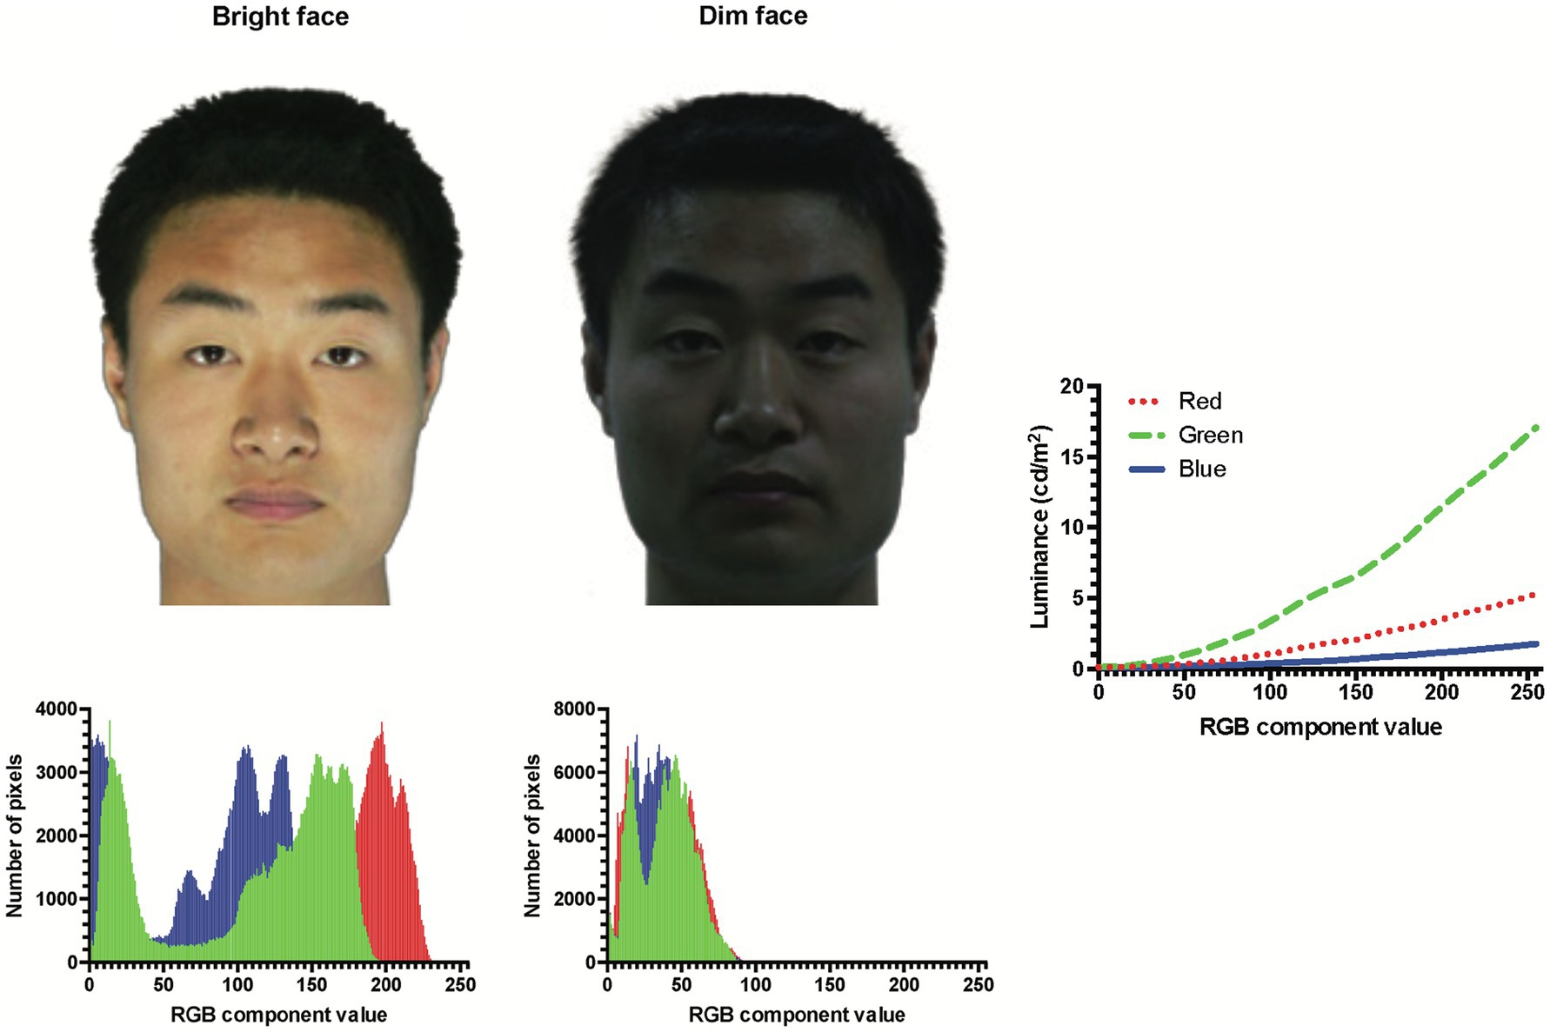
Challenges
Handling face detection accuracy under different lighting conditions.
Avoiding false positives caused by small natural head movements.
Managing real-time video processing without performance lag.
Implementing cooldown and hold-time mechanisms to prevent repeated alerts.

Slide 12
Advantages
Enables real-time automated monitoring of candidates during online examinations.
Detects face absence and multiple faces, reducing impersonation and proxy attempts.
Reduces dependency on manual invigilators, lowering operational costs.
Provides timestamped visual evidence through screenshots and logs for audit purposes.
Scalable solution suitable for large-scale online exams and assessments.
Improves fairness, transparency, and credibility of online examinations.

Slide 13
Conclusion
The AI-Based Real-Time Face Monitoring System provides an effective and scalable solution for maintaining integrity in online examinations. By continuously monitoring candidates through webcam video, the system successfully detects face absence, multiple faces, and suspicious movements in real time. Automated alerts, visual evidence capture, and detailed logging reduce dependency on manual invigilation while improving fairness and transparency. Overall, the project demonstrates how computer vision can be practically applied to enhance the reliability and credibility of modern online assessment systems.

Slide 14
Future Scope
Integration of face recognition for identity verification of candidates.
Implementation of eye gaze tracking to detect off-screen attention.
Addition of head pose estimation for more accurate movement analysis.
Cloud-based dashboard for centralized monitoring and analytics.

Slide 15


Slide 16

THANK YOU

